Slide 1


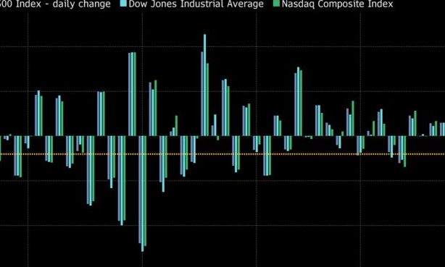

COVID-19, the Stock Market, & Unemployment
GROUP 3: SARAH BISMUTH, RACHEL WARD, ZHIHONG ZHANG, ZHIJING ZHANG

Slide 2
Agenda
Overview
Project Requirements
Data Sources
Conceptual Architecture
Demo & Insights
Project Milestones & Timeline
Team Responsibilities
Challenges
Lessons Learned

Slide 3
Project Overview
During this pandemic period, it is certain that Covid-19 is having an effect on the economy. We want to see how it affects the economy and stocks and unemployment are direct indicators of the economy. We would like to see the relationship between Covid-19 cases, stock, and unemployment in the United States.
Multiple Data Sources
Data Warehouse
Visualization & Analytical Insights

Slide 4
Project requirements
1. Design, Document, & Plan
Develop a conceptual design architecture
Develop data flow diagrams and data models
Define analytics concepts with bus matrix
Define ETL Instructions
Define data attributes
2. Develop and Build
Develop the warehouse solution using Amazon Web Services
Integrations:
Batch/Migration
Data Visualization (Tableau)
Code Repository (GitHub)
3. Test the Solution
Test the prototype
Optimization of the database may be necessary
Ensure that error-handling scenarios are considered
4. Present and Deliver
Deliver an executive presentation
Demo the architectural components
Demo the visualizations in a data visualization platform like Tableau

Slide 5



Data Sources
Coronavirus Data - New York Times
Stock Data - FRED API
Unemployment Data - U.S. Department of Labor

Slide 6
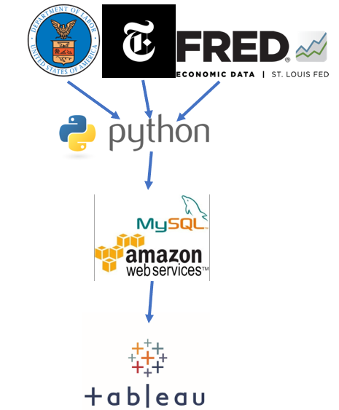
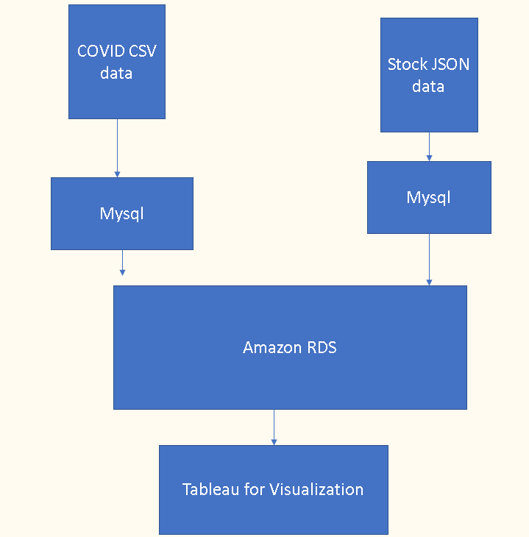
Conceptual architecture
Based on our model,
we set up this plan for
the data migration.

Slide 7
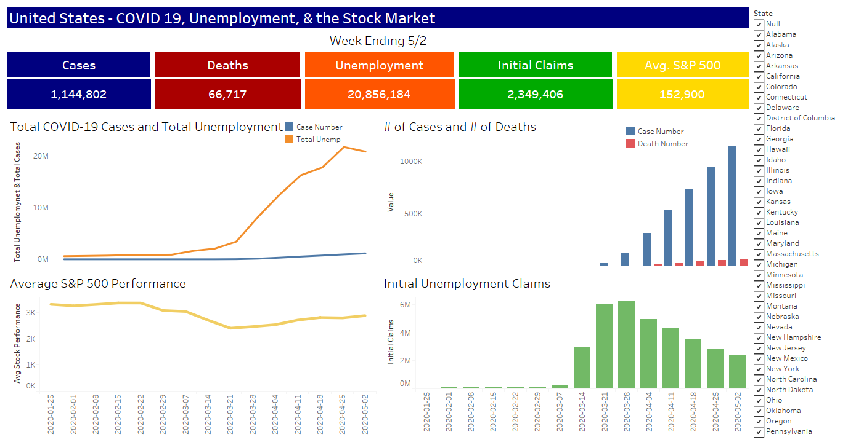
DEMO
DEMO

Slide 8
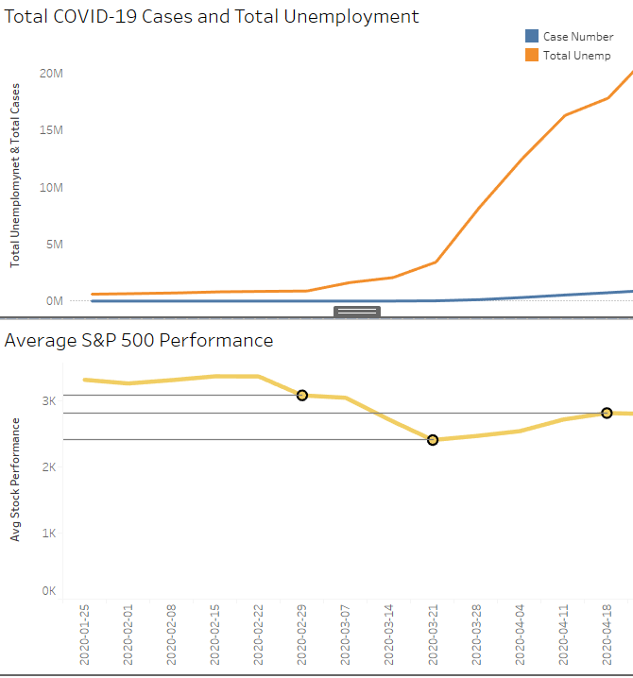
Demo Insights
These metrics all showed a strong correlations with the date.
The first confirmed case in New York (“NY”) was on Feb 29th, and we saw an increase of both unemployment and a drop in the S&P 500 after that date.
The average S&P 500 and unemployment data also show correlation over time. There is a slope change on March 21, 1 day after NY started lockdown.
Around the end of March is the highest rate of the the initial unemployment claims. This makes sense since many other states started lockdowns in the weeks immediately following NY.
Since the stock market is more related to the expectation of the future, when the lock down happened, the actual S&P 500 performed a bit better.
Also, the US federal government announced a 3 phase lock down plan (including ends of lockdown) on April 16. This also explains some slope change on unemployment and S&P 500 data.

Slide 9
Project Milestones and Timeline
Presentation
•CSV downloaded
•Web scraping code created and tested
•Use cases and bus matrix created
•High Level Waterfall Project Completed
•2 or more ETL processes completed
•Visualizations/edited finalized
•Scripts for loading data into AWS completed
•Preliminary trials of loading independent datasets into AWS completed
May 13
April 18
May 7
March 28
May 1
•Dimension model matrix with ETL instructions completed
•Conceptual, Logical, and Physical Data Model Completed
•Data Dictionary Completed
-presentation template completed
-finalize presentation & project materials

Slide 10
Team responsibilities
Sarah- Project Manager
Rachel-Lead Python Developer
Zhijing – Dataset Manager
Zhihong – Lead SQL Developer

Slide 11
Challenges
-Finding the right API
-Data preparation process
-Dimensional Modeling
-Deciding on the grain of the data
-Implementing our data into MySQL using RDS

Slide 12
Lessons learned
Python: Creating columns for the end date of the week is challenging, ensure that you take the day the week ends into account
Python > AWS RDS: pymysql is deprecated in the current version of Python, use a combination of pymysql and sqlalchemy
Tableau: Default settings in Tableau are problematic when sharing data and visualizations with a group

Slide 13
Q &A

